Slide 1
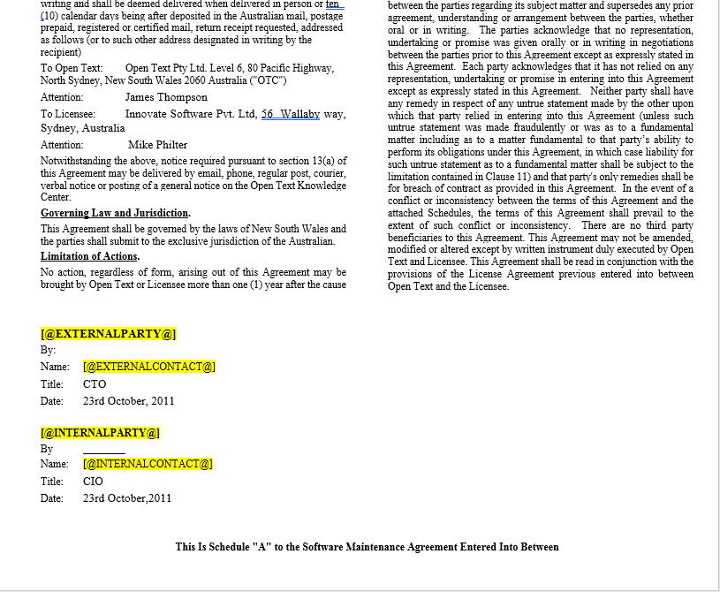
MS Word (Outside Application)

Slide 2
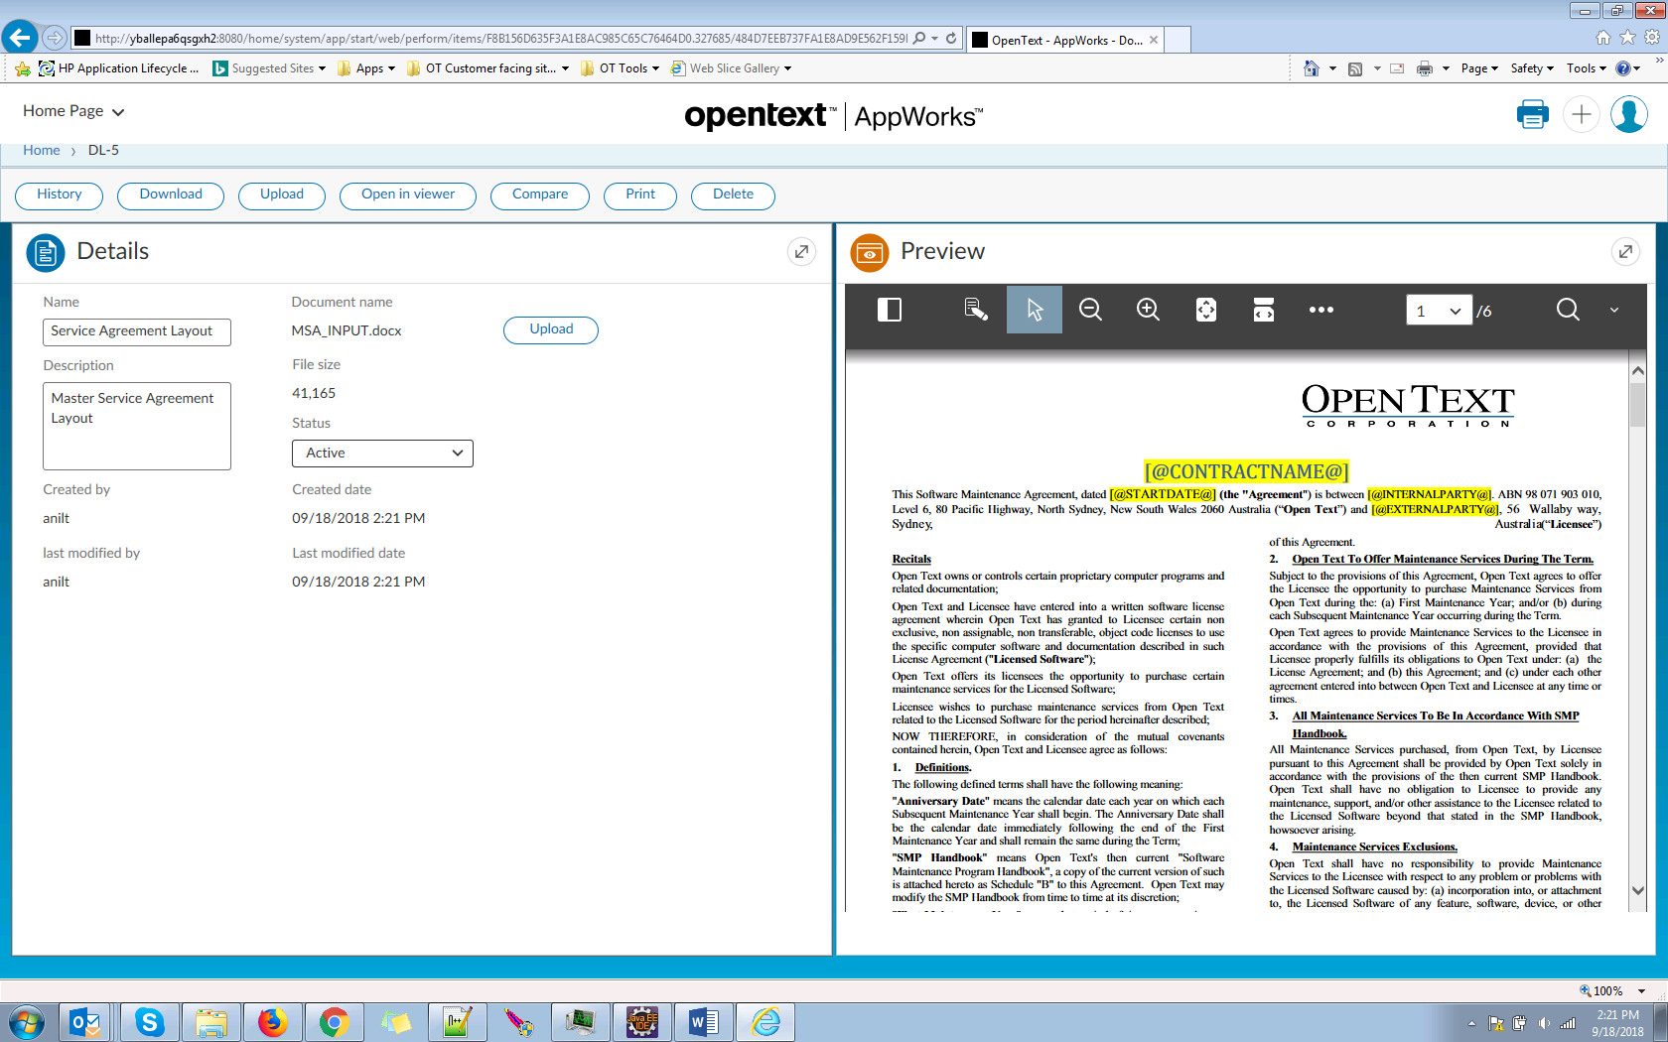
Upload Document Layouts

Slide 3
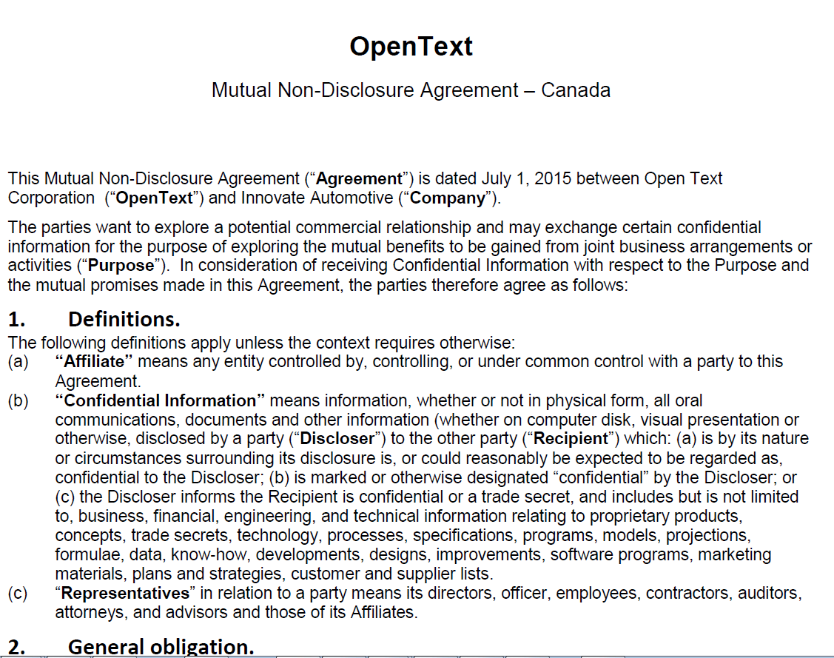
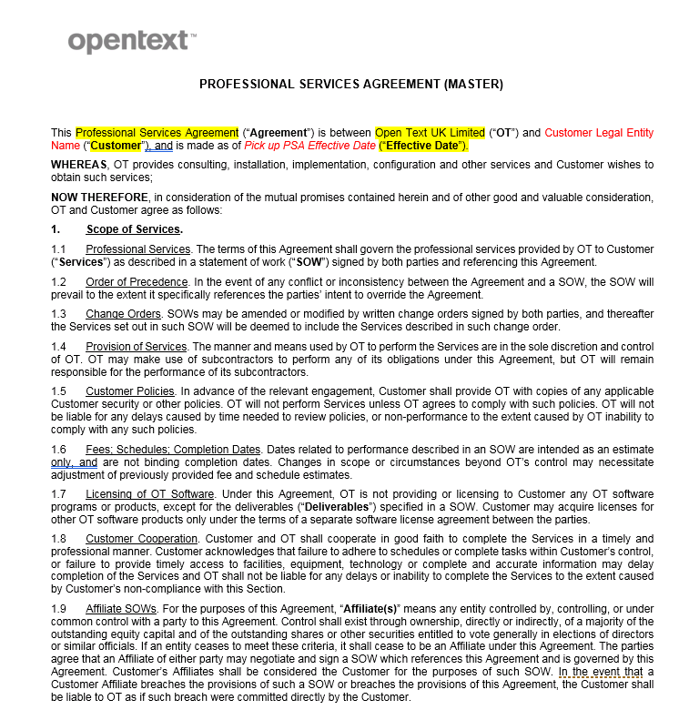
Type to Document Layout mapping
Contract Types
(NDA, MSA, Purchase Agreement, etc..)

Slide 4

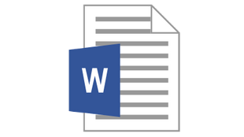
Document Generation Component
Process Platform/EM
Contract Center
Document Generation Component (As a Service)
Clause Entity
Layout Validator
Attributes, Sections & Clauses
1.*
1
Apache POI (TPP)
Template Entity
Content
1
Document Generator
1
Contract Entity
Contract Document

Slide 5
Generic Document Generation Component
Process Platform/EM
Contract Center Application
Attributes, Sections & Clauses
Document Generation Component (As a Service)
Layout Validator
People Center Application
Employee Properties etc..
Apache POI (TPP)
Legal Center Application
Content
Legal content etc..
Document Generator
Any other applications..
Attributes Key Value pair

